Slide 1
Text Classification
NER
QA POS

Slide 2
Text Classification
Text classification is a natural language processing (NLP) task that involves assigning predefined categories or labels to text data based on its content.
The goal is to automatically categorize text into one or more classes, which can be useful for various applications such as sentiment analysis, spam detection, topic labeling, and more.

Slide 3
Applications of Text Classification:
Sentiment Analysis: Determining the sentiment expressed in a piece of text (e.g., positive, negative, neutral).
Spam Detection: Classifying emails or messages as spam or not spam.
Topic Categorization: Assigning topics to articles or documents based on their content.
Intent Recognition: Understanding user intent in chatbots or virtual assistants.
Document Organization: Automatically categorizing documents for easier retrieval and management.

Slide 4
Text classification pipeline
1. Data Collection
Gather text data from various sources (e.g., documents, social media, websites).
2. Data Preprocessing
Text Cleaning: Remove noise such as HTML tags, special characters, and punctuation.
Tokenization: Split text into individual words or tokens.
Lowercasing: Convert all text to lowercase to ensure uniformity.
Stopword Removal: Remove common words that may not contribute to the meaning (e.g., "and", "the").
Stemming/Lemmatization: Reduce words to their base or root form.

Slide 5
Text classification pipeline
3. Feature Extraction
Bag of Words (BoW): Represent text as a collection of word counts.
Term Frequency-Inverse Document Frequency (TF-IDF): Weigh words based on their frequency in a document relative to their frequency in the entire dataset.
Word Embeddings: Use techniques like Word2Vec or GloVe to represent words in a continuous vector space.
4. Model Selection
Choose a classification algorithm. Common choices include: Logistic Regression, Naive Bayes, Support Vector Machines (SVM), Decision Trees, Random Forests, Neural Networks (e.g., LSTM, BERT)
5. Model Training
Split the dataset into training and testing sets.
Train the selected model on the training data.

Slide 6
Text classification pipeline
6. Model Evaluation
Evaluate the model using metrics such as accuracy, precision, recall, F1-score, and confusion matrix on the test set.
7. Hyperparameter Tuning
Optimize model performance by adjusting hyperparameters using techniques like Grid Search or Random Search.
8. Deployment
Deploy the trained model to a production environment where it can classify new, unseen text data.
9. Monitoring and Maintenance
Continuously monitor the model's performance and update it as necessary to handle changes in data distribution or to improve accuracy.

Slide 7
QA

Slide 8





Question
Answer
QA Model
Passage / context

Slide 9
QA
A QA (Question Answering) system is a type of artificial intelligence designed to automatically answer questions posed by users in natural language.
These systems can be used in various applications, such as customer support, information retrieval, and educational tools.

Slide 10
QA
Answer Generation: Once relevant information is retrieved, the system must generate a coherent and accurate answer. This can involve summarizing information, extracting specific data, or even generating text based on the retrieved content.
Types of QA Systems:
Closed-domain QA: These systems are designed to answer questions within a specific domain (e.g., medical, legal, technical).
Open-domain QA: These systems can answer questions across a wide range of topics and often rely on large-scale knowledge bases or the internet.
Machine Learning: Many modern QA systems use machine learning techniques, including deep learning, to improve their ability to understand questions and generate answers over time.
Examples: Some well-known QA systems include virtual assistants like Siri, Alexa, and Google Assistant, as well as specialized systems like IBM Watson and various chatbots.

Slide 11
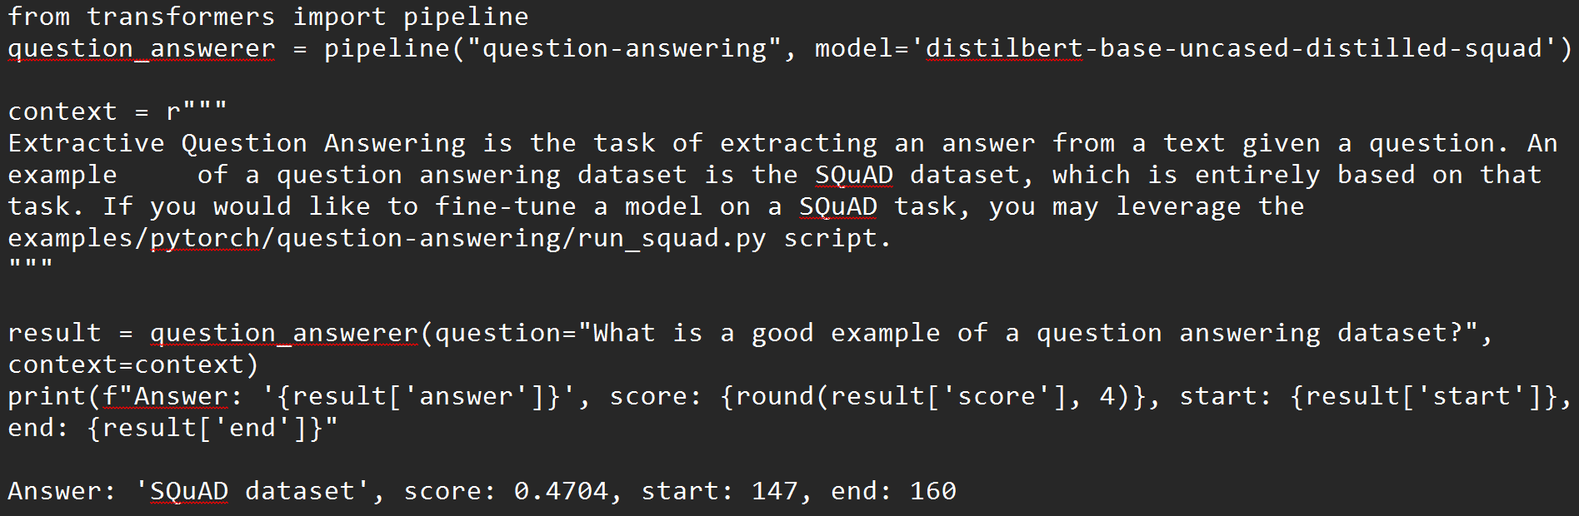

Slide 12
Named Entities Recognition
NER

Slide 13
Named Entities Recognition NER
Named Entity Recognition (NER) is a subtask of Natural Language Processing (NLP) that involves identifying and classifying named entities in text into predefined categories.
These entities can include names of people, organizations, locations, dates, quantities, and other specific items.
The primary goal of NER is to extract structured information from unstructured text, making it easier to analyze and understand.

Slide 14
Example NER
Person: Names of individuals (e.g., "Alessandro Felice").
Organization: Names of companies, institutions, or groups (e.g., "Fiat Chrysler Automobiles," "United Nations").
Location: Geographical locations (e.g., "Lecce", "Sicily").
Date: Specific dates or time expressions (e.g., "January 1, 2020").
Miscellaneous: Other entities that may not fit into the above categories, such as products or events.

Slide 15
Named Entities
Named entity, in its core usage, means anything that can be referred to with a proper name. Most common 4 tags:
PER (Person): “Marie Curie”
LOC (Location): “New York City”
ORG (Organization): “Stanford University”
GPE (Geo-Political Entity): "Boulder, Colorado"
Often multi-word phrases
But the term is also extended to things that aren't entities:
dates, times, prices
Notes:
Proper names are another important and anciently studied linguistic category. While parts of speech are generally assigned to individual words or morphemes, a proper name is often an entire multiword phrase, like the name “Marie Curie”, the location “New York City”, or the organization “Stanford University”.
Part of speech tagging can tell us that words like Janet, Stanford University, and Colorado are all proper nouns; being a proper noun is a grammatical property of these words. But viewed from a semantic perspective, these proper nouns refer to different kinds of entities: Janet is a person, Stanford University is an organization,.. and Colorado is a location. A named entity is, roughly speaking, anything that can be referred to with a proper name: a person, a location, an organization.
Four entity tags are most common: PER (person), LOC (location), ORG (organization), or GPE (geo-political entity). However, the term named entity is commonly extended to include things that aren’t entities per se, including dates, times, and other kinds of temporal expressions, and even numerical expressions like prices.

Slide 16
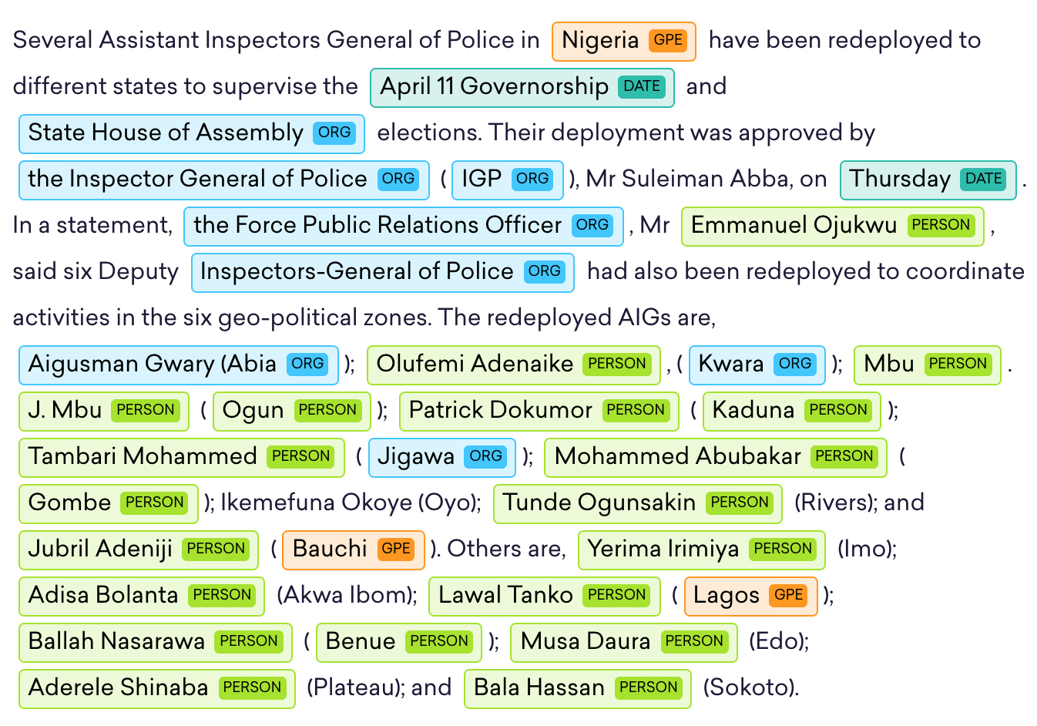
NER example

Slide 17
NER output
Notes:
Here's a text showing some sample Named Entity Recognition output. You'll see 13 mentions of named entities including 5 organizations, 4 locations, 2 times, 1 person, and 1 mention of money.

Slide 18
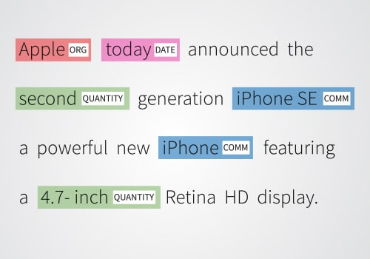
Why NER is hard!?
Comm = commercial product

Slide 19
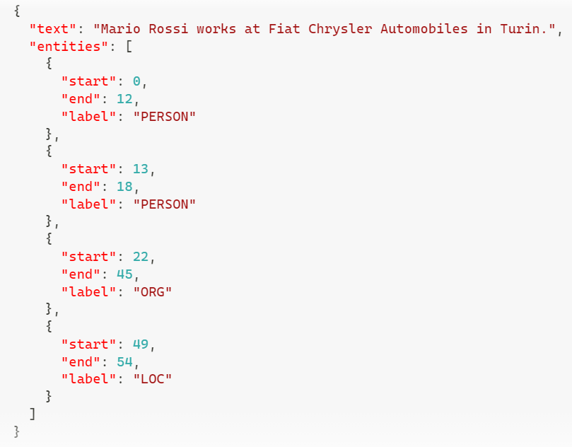
An example of dataset annotated with NEs

Slide 20
NER Modeling Approaches
Approach | Advantages | Disadvantages
Rule-based Systems | Simple and transparent No training data required | Limited flexibility and generalization Maintenance required for evolving language Performance may suffer on complex sentences
Machine Learning | Better generalization with training data Adaptable to specific domains | Requires feature engineering Performance relies on quality of training data More complex to implement
Deep Learning | State-of-the-art performance- Captures contextual information End-to-end learning | Requires large amounts of labeled data Computationally intensive Less interpretable (black box)

Slide 21
NER Modeling Approaches
Rule-based Systems: Using predefined rules and patterns (e.g., regular expressions) to identify entities.
Machine Learning: Training models on annotated datasets to recognize entities based on features extracted from the text.
Deep Learning: Utilizing neural networks, particularly architectures like LSTM, CRF (Conditional Random Fields), or Transformers (e.g., BERT), to achieve high accuracy in entity recognition.

Slide 22
Why NER?
Sentiment analysis: consumer’s sentiment toward a particular company or person?
Question Answering: answer questions about an entity?
Information Extraction: Extracting facts about entities from text.
Notes:
Named entity tagging is a useful first step in lots of natural language understand- ing tasks. In sentiment analysis we might want to know a consumer’s sentiment toward a particular entity. Entities are a useful first stage in question answering, or for linking text to information in structured knowledge sources like Wikipedia. And named entity tagging is also central to natural language understanding tasks of building semantic representations,

Slide 23
NER Applications
Information Extraction: Pulling structured data from unstructured text.
Search Enhancement: Improving search engine relevance by identifying key entities.
Content Recommendation: Suggesting articles or products based on recognized entities.
Sentiment Analysis: Understanding public sentiment towards specific entities.
Customer Support: Automating categorization of inquiries.
Social Media Monitoring: Tracking mentions and sentiment about brands or events.
Healthcare: Extracting medical entities from clinical notes.
Legal Document Analysis: Streamlining review processes by identifying legal entities.
Financial Analysis: Analyzing news for insights on companies and markets.
Chatbots: Enhancing user query understanding for better responses.

Slide 24
Sequence Labeling for Part of Speech and Named Entities
Part of Speech Tagging
Notes:
Let's introduce the task of part-of-speech tagging

Slide 25
Parts of Speech
From the earliest linguistic traditions (Yaska and Panini 5th C. BCE, Aristotle 4th C. BCE), the idea that words can be classified into grammatical categories
part of speech, word classes, POS, POS tags
8 parts of speech attributed to Dionysius Thrax of Alexandria (c. 1st C. BCE):
noun, verb, pronoun, preposition, adverb, conjunction, participle, article
These categories are relevant for NLP today.
Notes:
From the earliest linguistic traditions (the Sanskrit grammarians Yaska and Panini in India, the Aristotle and the Stoics in Greece), came idea that words can be classified into grammatical categories, what we now call parts of speech, word classes, or sometimes just for short, POS or POS tags.
By 100 BCE, Dionysius Thrax settled on a set of eight that became the basis for descriptions of European languages for the next 2000 years.
The durability of parts of speech through two millennia speaks to their centrality in models of human language.

Slide 26
Two classes of words: Open vs. Closed
Closed class words
Relatively fixed membership
Usually function words: short, frequent words with grammatical function
determiners: a, an, the
pronouns: she, he, I
prepositions: on, under, over, near, by, …
Open class words
Usually content words: Nouns, Verbs, Adjectives, Adverbs
Plus interjections: oh, ouch, uh-huh, yes, hello
New nouns and verbs like iPhone or to fax
Notes:
Let's talk about some parts of speech. While these word classes do have semantic tendencies—adjectives, for example, often describe properties and nouns people— parts of speech are defined instead based on their grammatical relationship with neighboring words or the morphological properties about their affixes.
Parts of speech fall into two broad categories: closed class and open class. Closed classes are those with relatively fixed membership, such as prepositions— new prepositions are rarely coined. By contrast, nouns and verbs are open classes— new nouns and verbs like iPhone or to fax are continually being created or borrowed. Closed class words are generally function words like of, it, and, or you, which tend to be very short, occur frequently, and often have structuring uses in grammar.
Four major open classes occur in the languages of the world: nouns (including proper nouns), verbs, adjectives, and adverbs, as well as the smaller open class of interjections. English has all five, although not every language does.

Slide 27
Open class ("content") words
Nouns
Verbs
Adjectives
old green tasty
Proper
Common
Main
Adverbs
slowly yesterday
Janet
Italy
cat, cats
mango
eat
went
Interjections
Ow hello
Numbers
… more
122,312
one
Closed class ("function")
Auxiliary
Determiners
the some
can
had
Prepositions
to with
Conjunctions
and or
Particles
off up
… more
Pronouns
they its
Notes:
Nouns are words for people, places, or things, but include others as well. Common nouns include concrete terms like cat and mango, abstractions like algorithm and beauty, and verb-like terms like pacing as in His pacing to and fro became quite annoying.
Verbs refer to actions and processes, including open-class main verbs like draw, provide, and go. and closed-class auxiliary verbs like "can", "will", "had" Auxiliary verbs can mark semantic features of a main verb such as its tense, aspect, or made.
Adjectives often describe properties or qualities of nouns, like color (white, black), age (old, young), and value (good, bad)
Other closed class or function words include Pronouns act as a shorthand for referring to an entity or event, or
conjunctions that join two phrases, clauses, or sentences, including Coordinating conjunc- tions like and, or, and but, or subordinating conjunctions like that in “I thought that you might like some milk” that links "the verb thought" with the clause "you might like some milk".

Slide 28
Part-of-Speech Tagging
Assigning a part-of-speech to each word in a text.
Words often have more than one POS.
book:
VERB: (Book that flight)
NOUN: (Hand me that book).
Notes:
Part-of-speech tagging is the process of assigning a part-of-speech to each word in a text.
Tagging is a disambiguation task; words are ambiguous —have more than one possible part-of-speech—and the goal is to find the correct tag for the situation.
For example, book can be a verb (book that flight) or a noun (hand me that book).

Slide 29
Part-of-Speech Tagging
Map from sequence x₁,…,x_{n} of words to y₁,…,y_{n} of POS tags
Notes:
Here's a sketch of part of speech tagging. The input is a sequence x1,x2,...,xn of (tokenized) words and a tagset, and the output is a sequence y1,y2,...,yn of tags, each output yi corresponding exactly to one input xi,

Slide 30
"Universal Dependencies" Tagset
Nivre et al. 2016

Slide 31
Sample "Tagged" English sentences
There/PRO were/VERB 70/NUM children/NOUN there/ADV ./PUNC
Preliminary/ADJ findings/NOUN were/AUX reported/VERB in/ADP today/NOUN ’s/PART New/PROPN England/PROPN Journal/PROPN of/ADP Medicine/PROPN
Notes:
Here are some sample tagged sentences. Notice that we have to make decisions about segmentation (punctuation, or the English 's is often segmented off as a particular), and the same word can have different tags in different sentences.

Slide 32
Why Part of Speech Tagging?
Can be useful for other NLP tasks
Parsing: POS tagging can improve syntactic parsing
MT: reordering of adjectives and nouns (say from Spanish to English)
Sentiment or affective tasks: may want to distinguish adjectives or other POS
Text-to-speech (how do we pronounce “lead” or "object"?)
Or linguistic or language-analytic computational tasks
Need to control for POS when studying linguistic change like creation of new words, or meaning shift
Or control for POS in measuring meaning similarity or difference
Notes:
Part of speech tagging is useful for NLP tasks, most notably for parsing, where it has long played a part, but also for machine translation, sentiment, or even text-to-speech systems. For example "lead" is pronounced "lead" when it is a noun, but "lead" when it is a verb, or "object" is pronounced OBject when it is a noun, but object when it is a verb.
Tagging is also important for linguistic or language-analytic computational tasks, like studying the creation of new words, or measuring meaning similarity or difference.

Slide 33
How difficult is POS tagging in English?
Roughly 15% of word types are ambiguous
Hence 85% of word types are unambiguous
Janet is always PROPN, hesitantly is always ADV
But those 15% tend to be very common.
So ~60% of word tokens are ambiguous
E.g., back
earnings growth took a back/ADJ seat
a small building in the back/NOUN
a clear majority of senators back/VERB the bill
enable the country to buy back/PART debt
I was twenty-one back/ADV then
Notes:
How hard is POS tagging. In English, only 15% of word types are ambiguous. So 85% of words don't need any disambiguating; Janet is always a proper noun, hesitantly is always an adverb.
But those 15% ambiguous words tend to be common words, and so they occur far more than 15% of the time; indeed around 60% of word tokens in running text are ambiguous. So for example the word "back" can have one of 5 part of speech tags.

Slide 34
POS tagging performance in English
How many tags are correct? (Tag accuracy)
About 97%
Hasn't changed in the last 10+ years
HMMs, CRFs, BERT perform similarly .
Human accuracy about the same
But baseline is 92%!
Baseline is performance of stupidest possible method
"Most frequent class baseline" is an important baseline for many tasks
Tag every word with its most frequent tag
(and tag unknown words as nouns)
Partly easy because
Many words are unambiguous
Notes:
How accurate are modern POS taggers? Quite accurate; for English, and a for a few other languages wwhere we have sufficient hand-labeled training data, and which have sufficiently simple morphology, tagging is a mostly solved problem.
The accuracy, that is, the percemtage of tokens that the tagger assigns the correct tag to, is about 97%
Of course, for English, the baseline itself is quite high. What's called the most frequent class baesline is simply to tag every word with its most frequent tag. For unknown words, tag them as nouns. This baseline gets around 92% accuracy, simply because, as we've seen, many words are not ambiguous.

Slide 35
Sources of information for POS tagging
Janet will back the bill
AUX/NOUN/VERB? NOUN/VERB?
Prior probabilities of word/tag
"will" is usually an AUX
Identity of neighboring words
"the" means the next word is probably not a verb
Morphology and wordshape:
Prefixes unable: un- → ADJ
Suffixes importantly: -ly → ADJ
Capitalization Janet: CAP → PROPN
Notes:
Part of speech taggers generally make use of three sources of information: let's consider disambiguating the words in the sentence "Janet will back the bill".
One source is the prior probability of the word having that tag; so the word "will" is usually an AUX, less frequently a Noun (like someone "of strong will") or VERB. Another source is the neighboring words. "the" usually precedes adjectives and nouns, not verbs. And the final is the makeup of the word itself; the prefex "un" often indicates an adjective, the suffix "ly" almost always an adverb, and capitalization is a strong hint word proper nouns.

Slide 36
Standard algorithms for POS tagging
Supervised Machine Learning Algorithms:
Hidden Markov Models
Conditional Random Fields (CRF)/ Maximum Entropy Markov Models (MEMM)
Neural sequence models (RNNs or Transformers)
Large Language Models (like BERT), finetuned
All required a hand-labeled training set, all about equal performance (97% on English)
All make use of information sources we discussed
Via human created features: HMMs and CRFs
Via representation learning: Neural LMs
Notes:
POS tagging can be done with classic supervised machine learning algorithms like Hidden Markov Models or Conditional Random Fields, or with neural models, either neural sequence models trained from scratch, or large language models, finetuned.
For English, with sufficient training data, all achieve about equal performance.
And all make use of the information sources we discussed; HMMs and CRFs via human-created features, and the neural models by inducing these features via representation learning.

